Slide 1

MASTER'S THESIS DEFENSE
Factors Influencing Consumer Purchase Intention in the Singapore Online Grocery Market
A Quantitative Study
Technology Acceptance Model (TAM) Framework Application
Presented by
Supervisor
Nguyen Thi Nhu Nguyen
Philip Snelle
Master of Science in International Business Management
December 2020

Slide 2
Introduction
Research Problem & Objectives
Research Gap
Research Objectives
Limited academic literature examining online grocery purchase intention specifically in Singapore's unique market context , despite the country's advanced digital infrastructure.
1
Review global online grocery market trends and factors influencing consumer purchase intention
2
Identify key determinants and analyze how they shape consumer action and behavior patterns
Problem Statement
3
Analyze the effectiveness of identified factors toward consumer purchase intention
Despite rapid global e-commerce growth, Singapore's online grocery market remains underdeveloped (only 3% of total consumption) due to strong traditional retail infrastructure and cultural shopping habits.
4
Recommend strategic improvements to enhance online grocery purchasing adoption
Research Aim
To examine factors affecting consumer purchase intention in Singapore's online grocery sector and quantify their degree of influence on consumer decision-making.

Slide 3
Market Context
Singapore Online Grocery Market Context
Market Characteristics
Consumer Behavior
Singapore possesses highly developed market economies and advanced digital infrastructure, yet online grocery adoption remains low at 11.9% of food and beverage purchases (Singstat, 2020).
Traditional Preference
Locals prefer physical stores and wet markets due to cultural habits
This paradox highlights the gap between technological capability and consumer behavior
Tech Adoption
Generation Y (21-29 years) and females show highest online adoption
Dominant Players
Household Size
Traditional supermarket chains maintain market control through extensive physical networks:
Medium-sized households (2-5 people) more likely to purchase online
NTUC FairPrice
Cold Storage
Sheng Siong
90+ stores
35 supermarkets
Local chain
Key Market Statistics
Emerging Competitors
Online Grocery Adoption
11.9%
Pure-play e-commerce firms (Shopee, RedMart/Lazada) are gaining traction with Shopee capturing the largest market share among online grocery platforms.
Total Online Consumption
3%
Smartphone Usage
67.7%

Slide 4
Literature Review
Theoretical Framework: Technology Acceptance Model (TAM)
TAM Foundation
Extended Application
Davis, Bagozzi, & Warshaw (1989)
This study integrates TAM with additional theoretical perspectives to create a comprehensive framework:
The Technology Acceptance Model was developed to measure technology acceptance in retail contexts , providing a robust framework for understanding user adoption of new technologies.
Convenience context-based concepts
Emotional perspectives (perceived risk)
TAM has become one of the most influential models in technology adoption research
Social influence factors (consumer reviews)
Theoretical Integration
Core Constructs
The study combines cognitive response (TAM) with emotional interaction factors to understand online grocery purchase intention comprehensively.
PU
Perceived Usefulness
The degree to which a person believes that using a particular system would enhance their job performance
Integration Models: Theory of Reasoned Action (TRA), convenience context-based concept, and e-WOM literature
PEOU
Perceived Ease of Use
The degree to which a person believes that using a particular system would be free of effort
These constructs are fundamental predictors of technology adoption behavior

Slide 5
Literature Review
Research Variables & Hypotheses
IV1
Consumer Behaviour (CB)
IV2
Online Shopping Experience (SE)
IV3
Convenience (C)
Shopping habits, orientation, and motivation affecting online purchase decisions
Prior experience with online tools, shopping habits, and interactive processes
Time-saving, accessibility, search convenience, and transaction ease
Key Elements: Shopping motivation, web design, information quality, payment systems
Key Elements: Web atmospherics, prior knowledge, emotional responses
Key Elements: Access convenience, transaction ease, possession, post-possession
IV4
Perceived Risk (PR)
IV5
Consumer Reviews (CR)
DV
Purchase Intention (PI)
Consumer beliefs about potential negative outcomes in online purchasing
Electronic Word-of-Mouth (e-WOM) influencing purchase decisions through trust
Consumer expectation and possibility of purchasing groceries online
Risk Types: Financial, product, delivery, privacy, psychological, time, social
Review Types: Relative reviews, anonymous reviews, professional reviews
Definition: Expectance of purchasing with reference cost in specific time framework

Slide 6
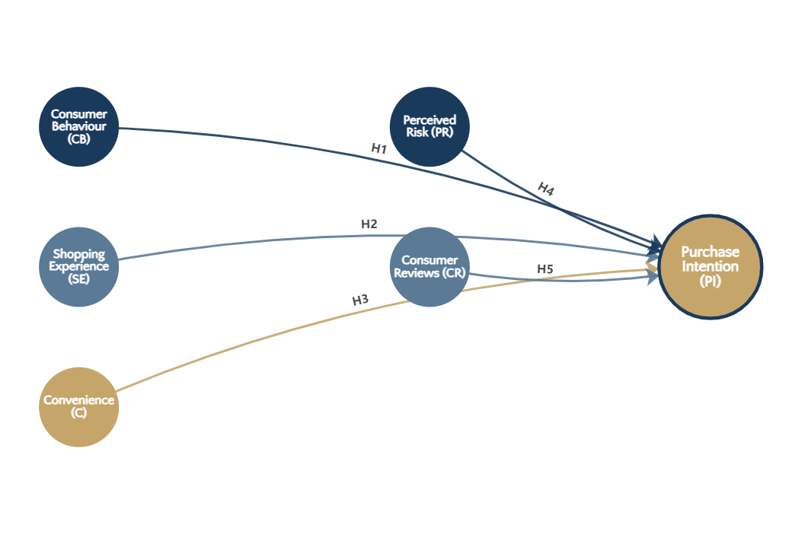
Conceptual Framework
Conceptual Framework & Hypothesis Mapping
Research Model: Variable Relationships
Five Research Hypotheses
H1: Consumer behaviour → PI (+)
H2: Shopping experience → PI (+)
H3: Convenience → PI (+)
H4: Perceived risk → PI (+)
H5: Consumer reviews → PI (+)
Variable Classification
Independent Variables: CB, SE, C, PR, CR
Dependent Variable: Purchase Intention (PI)

Slide 7
Methodology
Research Methodology
Research Design
Measurement Scale
Five-point Likert Scale adapted from established literature:
Quantitative approach using web-based self-completion survey for hypothesis testing. This method provides:
1 = Strongly Disagree
5 = Strongly Agree
Time-effective data collection
Generalizable findings
Data Analysis
High perceived anonymity
Reduced social desirability bias
SPSS Software for comprehensive statistical analysis:
Descriptive Statistics
Sampling Strategy
Exploratory Factor Analysis (EFA)
Survey Invitations
150
Pearson Correlation Analysis
Valid Responses
129
Multiple Linear Regression (MLR)
Response Rate
86%
Distributed via email and social media (Facebook, Twitter, Instagram)

Slide 8

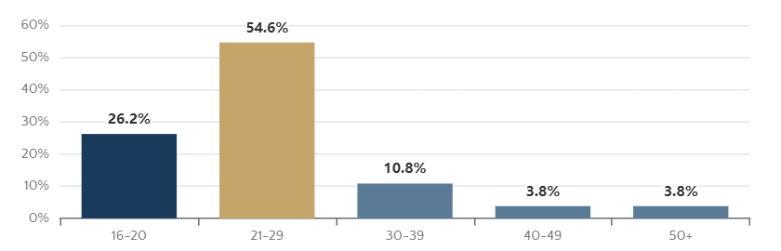
Data Analysis
Sample Demographics & Profile
Gender Distribution (n=129)
Key Demographic Insights
Female Dominance
66.7% of respondents are female, indicating higher online grocery interest among women
Generation Y Focus
54.6% aged 21-29 years, representing tech-savvy consumers
Smartphone Preference
67.7% use smartphones for online purchases
Moderate Engagement
54.6% shop 1-3 times monthly; 63.8% spend <500 SGD
Age Composition
Occupation & Internet Usage
Students
51.5%
Employed
37.7%
>2 Years Internet Use
45.4%

Slide 9
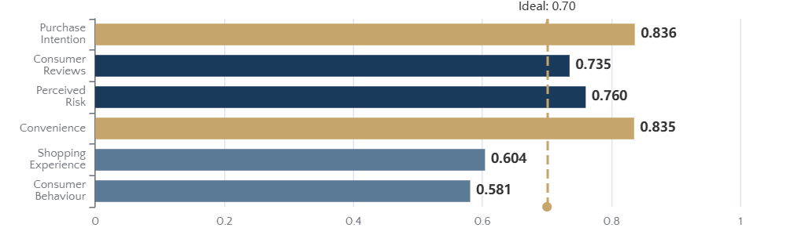
Data Analysis
Reliability Analysis & Factor Validation
Cronbach's Alpha Reliability Results
Reliability Assessment
Convenience (C)
0.835
Excellent reliability
Purchase Intention (PI)
0.836
Excellent reliability
Perceived Risk (PR)
0.760
Acceptable Range: 0.60 - 0.95
Ideal Threshold: > 0.70
Good reliability
Factor Analysis Validity
Consumer Reviews (CR)
0.735
Acceptable reliability
KMO Measure
Bartlett's Test
0.723
p < 0.001
> 0.50 (Acceptable)
Significant
Variance Explained: Component 1 explains 75.389% of total variance, indicating strong construct validity for Purchase Intention

Slide 10
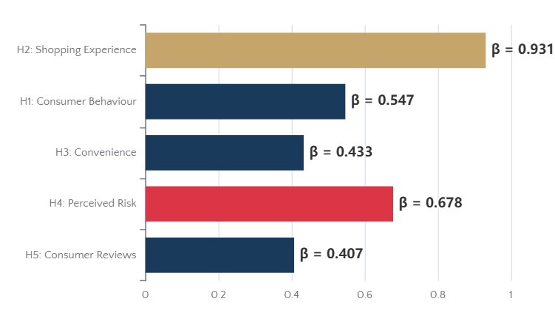
Data Analysis
Hypothesis Testing Results: Multiple Linear Regression
Model Fit Statistics
Path Coefficients Visualization
Adjusted R²
F-Statistic
Durbin-Watson
0.689
57.656
1.952
68.9% variance explained
p < 0.001 ***
No autocorrelation
Interpretation: The model explains 68.9% of variance in Purchase Intention, indicating strong predictive power. ANOVA F-test confirms significant relationship (p < 0.001).
Hypothesis Testing Summary
Hypothesis | β | p-value | Result
H1: CB → PI | 0.547 | < 0.001*** | SUPPORTED
H2: SE → PI | 0.931 | < 0.001*** | SUPPORTED
H3: C → PI | 0.433 | < 0.001*** | SUPPORTED
H4: PR → PI | 0.678 | 0.796 ns | NOT SUPPORTED
H5: CR → PI | 0.407 | < 0.001*** | SUPPORTED
Multicollinearity Check
All VIF Values
< 10
Interpretation: VIF values range from 1.074 to 2.460, well below the threshold of 10, indicating no multicollinearity issues.
*** p < 0.001; ns = not significant

Slide 11
Findings & Discussion
Key Findings & Discussion
Four Significant Factors
Perceived Risk: Insignificant
Consumer behaviour, online shopping experience, convenience, and consumer reviews significantly enhance online grocery purchase intention, supporting the extended TAM framework.
H4 not supported (p = 0.796), contradicting previous literature. Potential explanations:
Sample characteristics: tech-savvy respondents less risk-averse
Model explains 68.9% of variance in Purchase Intention
Singapore's secure e-commerce infrastructure reduces concerns
Risk affects satisfaction more than initial intention (Ariffin et al., 2018)
Strongest Predictor
Gender & Age Differences
Shopping Experience (β = 0.931) emerges as the most influential factor. High internet adoption among Generation Y drives positive online purchase intention.
Female Consumers
Show higher susceptibility to influencing factors; dominate personal care and house care purchases
Positive experience → Higher intention
Generation Y (21-29)
Highest online adoption; older generations face technology barriers
Generation Y most responsive
Product Category Preferences
Personal Care & House Care
HIGH
Packaged Food
MODERATE
Fresh Food & Produce
LOW

Slide 12
Conclusion
Recommendations & Conclusion
For E-Commerce Firms
Research Limitations
1
Enhance User Experience: Focus on website design, navigation, and seamless transaction processes
Sample skewed toward young, tech-savvy respondents
Online survey excludes low technology adoption groups
Perceived risk insignificance may require larger sample validation
2
Target Generation Y & Females: Develop marketing strategies tailored to these high-adoption segments
Cross-sectional design limits causal inference
3
Engage Older Demographics: Create innovative, user-friendly approaches to overcome technology barriers
Future Research Directions
Expand sample size and age diversity
For E-Retailers
Incorporate qualitative methods (interviews)
1
Provide Comprehensive Information: Detailed product descriptions and quality assurance
Examine specific grocery product categories
2
Maintain Quality Standards: Reduce perceived risk through consistent product quality
Investigate perceived risk and satisfaction relationship
3
Actively Manage Reviews: Respond to consumer feedback and address negative reviews promptly
Conclusion
This study successfully identifies four key factors driving online grocery purchase intention in Singapore, contributing valuable insights to this under-researched market segment and providing practical recommendations for e-commerce stakeholders.

